Slide 1

Presented by
Chelsea Hefferin, Miqueas Herrera, Jacob Isdell, Jimmy Jones

Slide 2


Let us introduce ourselves
Chelsea Hefferin
I work in business relations for Paypal. I want to work more deeply with integration which has lead on this developer path.
Miqueas Herrera
A little about me is that I'm currently in Texas and I am a big gamer and avid robot and most things science fan!

Slide 3

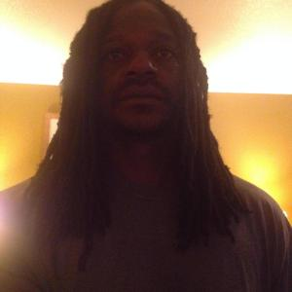
Jacob Isdell
I'm a web developer at Shipt. I spend my free time playing video games, working on home improvement projects, and hanging out with my wife.
Jimmy Jones
I work for Target in Financial products. My heart and mind are more into Cyber or Data Analytics rather than software development.

Slide 4
About Bacchus
Welcome to Bacchus Winery: Where Tradition Meets Innovation
At Bacchus Winery, we honor the legacy of our founder, George Bacchus, while embracing the exciting possibilities of the future. As Stan and Davis Bacchus, the new stewards of our vineyard, we’re committed to enhancing both our products and the experience for our valued customers.

Slide 5
objective
Bacchus Winery is focused on improving business operations through better management and tracking of key areas such as inventory, distribution, and employee performance. The winery produces four types of wine—Merlot, Cabernet, Chablis, and Chardonnay—and relies on multiple suppliers for essential components like bottles, corks, labels, boxes, vats, and tubing. Stan and Davis aim to implement an efficient system for tracking inventory, supplier performance, wine sales, and employee work hours. This includes monitoring supplier deliveries, tracking inventory levels, and generating reports on order timing and stock levels. For wine distribution, the goal is to track sales by wine type and distributor, identifying top performers and underperformers, while linking sales to specific distributors. Additionally, they seek to track employee hours worked, payroll, and time spent on tasks such as production, marketing, and distribution, to optimize staffing and productivity. Overall, Bacchus Winery seeks to streamline operations, enhance decision-making, and improve overall business performance.

Slide 6
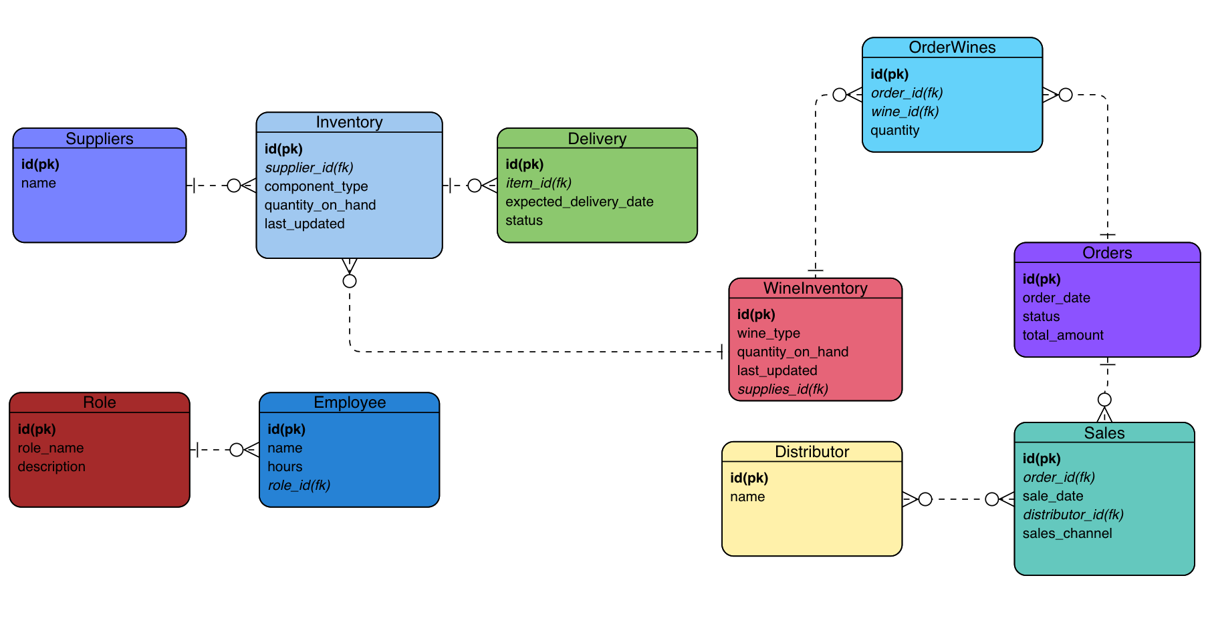
Final ERD

Slide 7
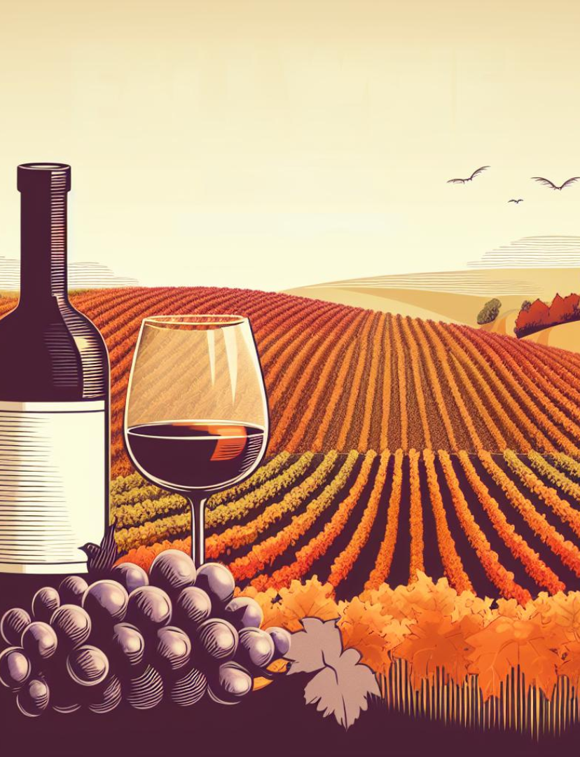
reporting Overview

Slide 8
Reports
At Bacchus Winery, we are committed to optimizing business operations and improving decision-making through the collection and analysis of key performance data. Our comprehensive reports provide valuable insights into critical areas such as inventory management, distribution performance, employee productivity, and supplier reliability. Detailed sales data by wine type and distributor, enabling us to identify top-performing distributors and uncover opportunities for growth. Comprehensive tracking of employee hours worked across departments (Production, Marketing, Distribution, etc.), offering a clear view of staffing efficiency and productivity. Monitoring of supplier performance, highlighting any delays or upcoming deliveries, and ensuring timely availability of essential components like bottles, corks, labels, and packaging materials. By leveraging these reports, Bacchus Winery can make data-driven decisions that streamline operations, improve supply chain reliability, enhance workforce efficiency, and ultimately support our goal of driving sustained growth and profitability.

Slide 9
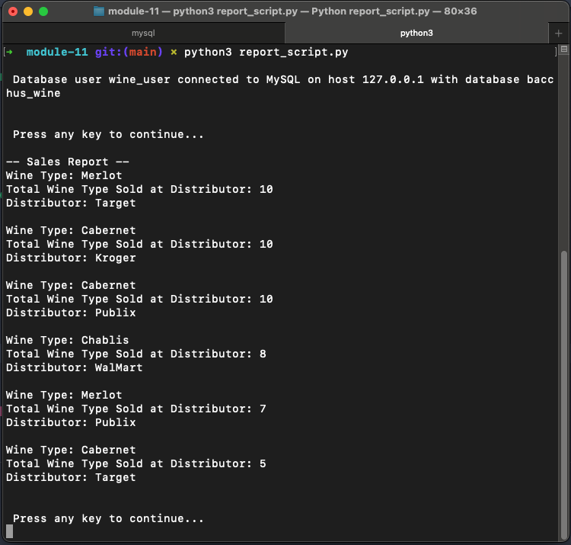
Report 1: Sales
Shows total wine sold by type at each distributor.
Cabernet is the most popular wine in general.
Merlot is the most popular wine sold at Target.

Slide 10
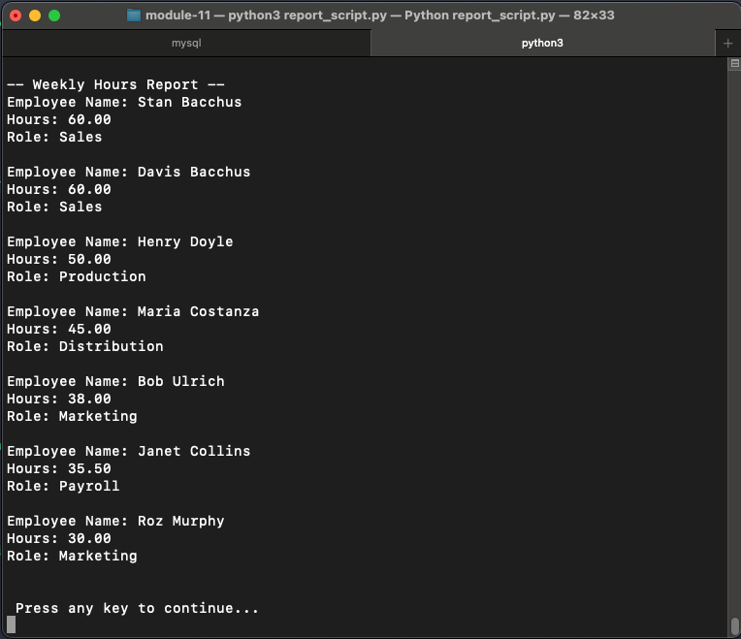
Report 2: Hours
Stan and Davis put in the most hours in the past week with 60 each.
Henry and Maria are pulling overtime, but their roles are more demanding.
Bob, Janet, and Roz are all currently working less than 40 hours.

Slide 11
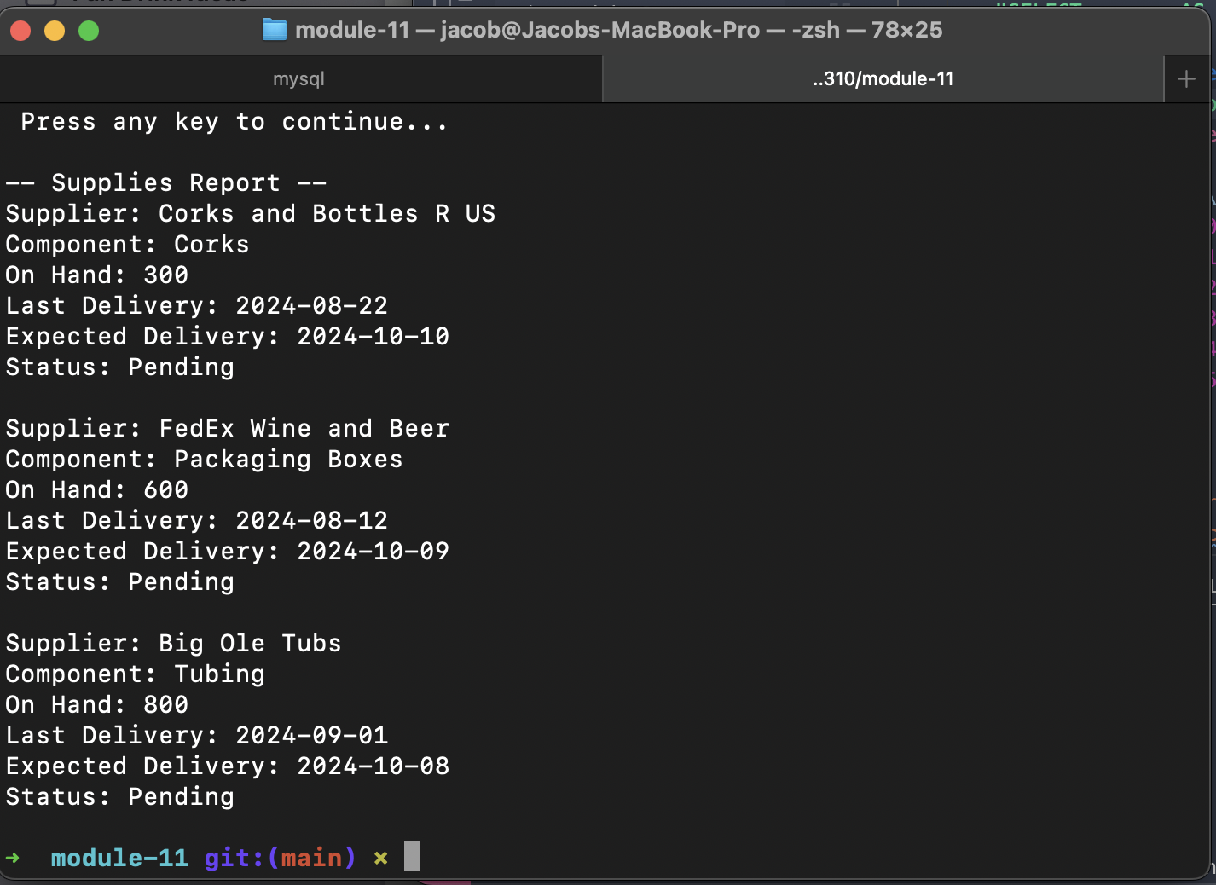
Report 3: Supplies
All supplies are due in this month.
Corks are running a little low, and might need to be ordered more regularly.

Slide 12
Assumptions
For reporting purposes, the following assumptions have been applied.
Hours report is for weekly hours worked. Stan and Davis are salaried but still clock in and out.
Wines sold to retailer needed to be broken down per wine type for better accuracy.
Employees work with a max of 60 hrs per weerk.
Most sales are B2B, but Bacchus sells direct to consumer as well.

Slide 13
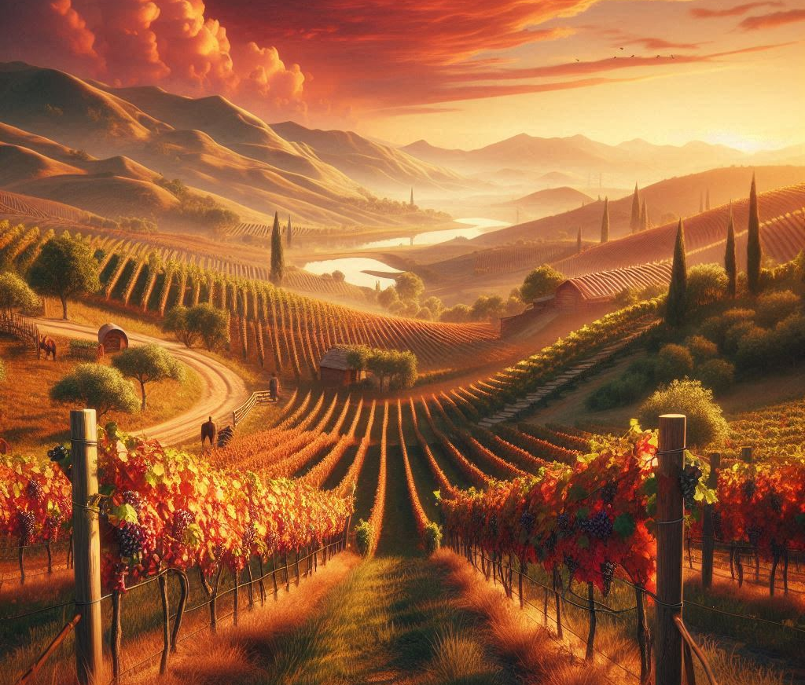
THANK YOU

